Slide 1
Team Synergy

Slide 2
Table of contents
1.Our Team
3.Work progress
2. About the idea
4.Programs used

Slide 3

01
OUR TEAM

Slide 4
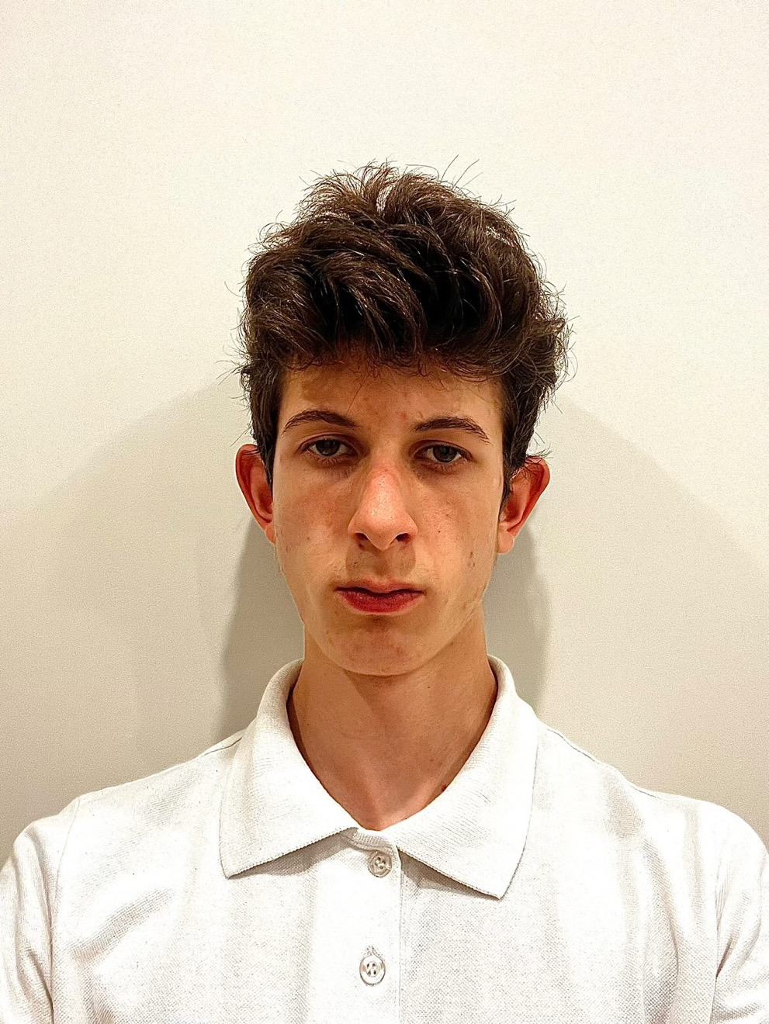
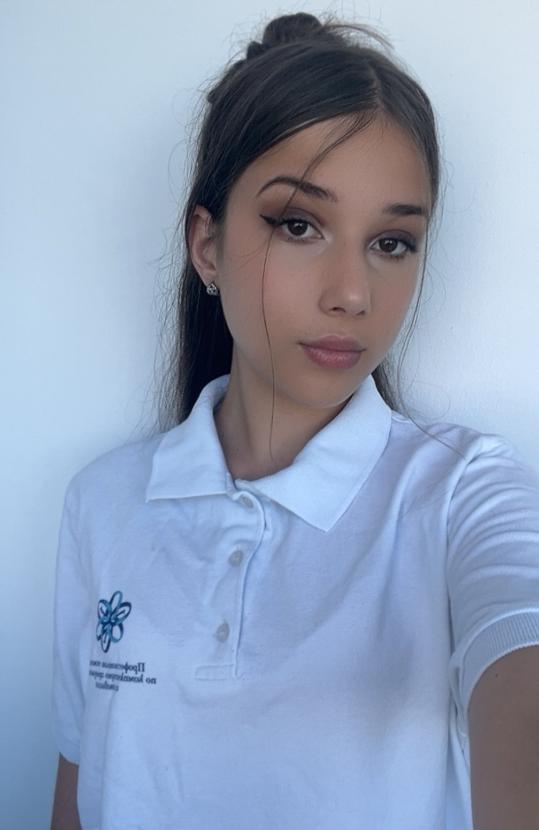

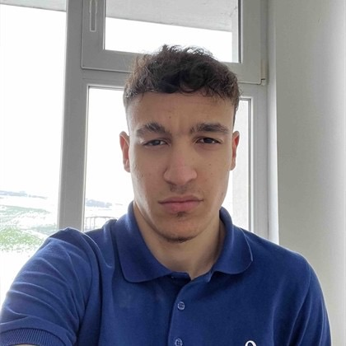
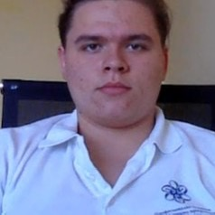
Aleksander Georgiev
Anastas Apostolov
Back-end Dev
Front-end Dev
Alexey Atanasov
Valeriya Vulchanova
QA
Scrum trainer

Slide 5
02
About the idea

Slide 6

Our idea is a simple 2D maze where the player controls a small dot. At every intersection(more than 1 possible path to go), smaller dots appear around the main one, the player must tap one to move forward. Every five levels, the maze becomes more complex, making it harder to find the right path and reach the goal. For example on further levels teleporters appear and there is also a timer

Slide 7
03
Work progress

Slide 8
Period | Monday | Tuesday | Wednesday | Thursday | Friday | Saturday | Sunday
21.10-28.10
29.10-05.11
06.11-13.11

Slide 9
04
Programs used

Slide 10










Slide 11
Let’s dive into the project itself

